Slide 1

WATER POLLUTION ALERT SYSTEM
Team Details:
Names:S.DHAKSHINA SHRI / 211423104119
B. DARSHINI/211423104105
Batch Number:A8 Domain: Internet of Things
Guide Name & Designation : ALIMA BEEVI A M.E.,

Slide 2

Agenda
Introduction
Abstract
Objective
Literature Survey
Problem Statement
Architecture & Use Case Diagrams
Modules
Methodology / Algorithms
Testing & Validation
Performance Analysis
Screenshots
Conclusion & Future Work
References

Slide 3

Abstract
The Water Pollution Alert System aims to provide an efficient and automated method for analyzing and detecting water pollution levels.
The system utilizes image processing techniques to evaluate the color, clarity, and visual properties of water samples to determine their quality status.
It classifies the water as Clean, Moderately Polluted, or Highly Polluted based on extracted image features and predefined threshold values.
The implementation is carried out using Python, with libraries such as OpenCV, NumPy, and ReportLab for image analysis and report generation.
The project serves as a simulation prototype that mimics IoT-based pollution monitoring, where physical sensors can be integrated in future enhancements.
This system demonstrates a cost-effective, digital, and scalable approach to monitor water quality and generate real-time alerts or reports to assist in environmental protection and resource management.

Slide 4
Introduction
Water pollution is one of the most critical environmental challenges, caused by the discharge of harmful substances into water bodies.
It severely affects aquatic life, ecosystem balance, and human health by contaminating water sources.
Traditional methods for assessing water quality involve manual sampling and laboratory testing, which are time-consuming, expensive, and not suitable for continuous monitoring.
With the advancement of technology, automated water quality monitoring systems have become essential for faster detection and prevention of pollution.
This project introduces a Water Pollution Alert System that uses image processing and analysis techniques to determine the pollution level of water based on visual parameters such as color and clarity.
The system acts as a simulation model representing real-time IoT behavior, where future integration with sensors and cloud platforms can enable smart environmental monitoring and early pollution alerts.

Slide 5

Objective
To develop an automated system capable of analyzing and detecting water pollution levels using image processing techniques.
To replace traditional manual testing methods with a faster, cost-effective, and scalable digital approach.
To classify water quality into categories such as Clean, Moderately Polluted, and Highly Polluted based on visual parameters.
To generate alerts and detailed PDF reports that summarize pollution levels and analysis results.
To design a simulation prototype that mimics an IoT-based system for future integration with real-time sensors (pH, turbidity, temperature).
To contribute toward environmental protection and smart monitoring through early pollution detection and timely response.

Slide 6
Research and Literature Review
1. Low-cost water-quality sensors (systematic review)
Aspect | Details
Author | E. T. de Camargo et al., Low-Cost Water Quality Sensors for IoT (2023).
Summary | Systematic review of commercially available low-cost sensors used for remote water monitoring; compares sensor types, cost ranges, measured parameters (pH, turbidity, DO, conductivity), and typical accuracy trade-offs
Relevance | Shows which inexpensive sensors can enable dense monitoring networks and supports design decisions for field prototypes and student projects
Gaps | Many low-cost sensors lack long-term field validation, suffer drift and cross-sensitivity; calibration procedures and environmental robustness are inconsistently reported.
Impact | Enables affordable, scalable monitoring deployments but highlights the need for standard calibration protocols and QA/QC before regulatory use

Slide 7
Research and Literature Review
2. Machine-learning for water-quality prediction and classification
Aspect | Details
Author | M. Zhu et al., A review of the application of machine learning in water (2022).
Summary | Survey of ML methods (random forests, SVM, neural nets, LSTM) applied to classification/forecasting of water quality across surface water, groundwater and drinking water applications. Discusses feature selection, evaluation metrics, and examples of improved predictive skill over simple statistical models
Relevance | Shows how ML models can turn sensor + historical data into forecasts/alerts, improving early warning compared to threshold rules. Useful for upgrading a prototype alert system to predictive alerts
Gaps | Requires large, well-labelled datasets; suffers from overfitting, lack of transferability between basins, and interpretability of complex models. Data gaps and sensor noise limit real-world deployment.
Impact | When combined with field sensors, ML can raise lead time for interventions and help prioritize sampling; demands strong data pipelines and model validation

Slide 8
Research and Literature Review
3. IoT architectures and real-time alert systems
Aspect | Details
Author | J. Tang et al., Design and realization of a water quality monitoring system (2024) and related IoT reviews.
Summary | Describes practical IoT stacks (microcontroller like ESP32/RPi, sensors, MQTT/HTTP telemetry, cloud dashboard, SMS/email alerting). Reviews document tradeoffs in connectivity, power, and data visualization
Relevance | Direct blueprint for building a deployed alerting pipeline (edge sensing → gateway → cloud → notification). Matches the alert/report functionality in your uploaded prototype.
Gaps | Key operational issues: network reliability, energy (remote power), cybersecurity, maintenance and sensor fouling in long-term deployments. Many papers note the lack of integrated cost/maintenance studies.
Impact | Real-time IoT alerts transform monitoring into actionable systems for managers and first responders — but require investment in ruggedization, secure comms, and maintenance plans

Slide 9
Research and Literature Review
4. Cloud and Big Data Analytics in Water Quality Monitoring
Aspect | Details
Author | P. Singh et al., “Cloud-Based Big Data Framework for Water Quality Monitoring and Forecasting,” IEEE Access (2023)
Summary | Proposes an integrated system that uses IoT-enabled sensors to stream water quality data to a cloud platform (AWS/Azure). Implements Spark-based analytics for real-time visualization and anomaly detection. Demonstrates scalable handling of large sensor datasets from multiple river sites.
Relevance | Shows how cloud infrastructure enhances scalability, data storage, and analytics — aligning perfectly with projects that evolve from prototype to region-wide systems.
Gaps | High cloud operation cost, data privacy concerns, and limited offline functionality in low-connectivity zones. Standardization of APIs and interoperability between sensor vendors remains unresolved.
Impact | Enables real-time, multi-location monitoring with predictive analytics. Supports environmental agencies and public dashboards for transparency and public awareness.

Slide 10
Research and Literature Review
5. Health Risk Assessment and Water Pollution Monitoring
Aspect | Details
Authors | K. Shah et al., Human Health Risk Assessment of Contaminated Water Sources Using IoT and Data Analytics (2023)
Summary | Evaluates IoT-enabled systems that integrate chemical sensors and epidemiological models to estimate human health risks (e.g., heavy-metal exposure, microbial contamination). Describes linking WQI parameters to dose–response models.
Relevance | Highlights the importance of translating raw sensor data into human-risk indicators—extending simple alerts into actionable community warnings.
Gaps | Existing studies mostly simulate risk using ideal datasets; few provide field validation or population-level outcomes. Ethical data-sharing and privacy guidelines are also limited.
Impact | Improves decision-making for municipal health departments and water authorities by connecting monitoring data to preventive healthcare actions.

Slide 11
Research and Literature Review
6.River Water Quality data at different monitoring stations
Aspects | Details
Authors | Environmental Protection Department (EPD), Hong Kong -River Water Quality Data at Different Monitoring Stations (1986–2022),
Summary | Contains long-term records of river water quality from 1986 to 2022 at multiple monitoring stations in Hong Kong. Parameters include BOD, COD, ammonia, metals, and other indicators of water pollution.
Relevance | Useful for analyzing long-term trends in water pollution and assessing the impact of environmental policies; valuable reference dataset for IoT or AI-based water quality prediction systems.
Gaps | Limited real-time data; variations in station coverage and sampling consistency; lacks newer pollutant parameters and detailed metadata on methodology changes.
Inspects | Provides a 35+ year historical baseline that supports environmental research, pollution trend analysis, and calibration for smart monitoring systems.

Slide 12
Research and Literature Review
7. Federated Knowledge Distillation
Aspects | Details
Authors | H. Seo, J. Park, S. Oh, M. Bennis, and S. Kim
Summary | Proposes a method for collaborative model training without sharing raw data, where multiple clients distill their knowledge through logits to a shared global model instead of exchanging parameters.
Relevance | Highly relevant for privacy-preserving IoT and distributed water-quality monitoring, allowing edge devices to contribute to a global pollution prediction model without data leakage.
Gaps | Requires reliable communication and sufficient client diversity; performance may drop with small or non-IID datasets; limited validation on real-world IoT sensor data.
Inspects | Enables secure and communication-efficient federated learning; can significantly improve scalability and privacy in environmental or IoT-based monitoring systems

Slide 13
Research and Literature Review
8. Guidelines for safe recreational water environments: Coastal and fresh waters
Aspects | Details
Authors | World Health Organization (WHO), Guidelines for Safe Recreational Water Environments: Coastal and Fresh Waters
Summary | Provides global health-based guidance for managing risks in recreational waters, covering microbiological, chemical, and physical hazards affecting public health and water quality standards.
Relevance | Important reference for setting safety thresholds in river and lake water-quality monitoring projects; supports defining alert limits in IoT-based water pollution systems.
Gaps | Focuses mainly on human health protection and may not address localized pollution patterns or emerging contaminants; limited integration with real-time sensor technologies.
Inspects | Establishes internationally recognized safety criteria and best practices that can guide water-quality monitoring frameworks and public health policies.

Slide 14
Research and Literature Review
9. Water contami- nation and human health risks in Pakistan: a review
Aspects | Details
Authors | M. Fida, P. Li, Y. Wang, S. K. Lam, and A. Nsabimana
Summary | Reviews major sources of water contamination in Pakistan, including industrial waste, agricultural runoff, and poor sanitation. Discusses chemical, biological, and heavy metal pollutants and their associated health risks.
Relevance | Provides insight into pollution patterns and their human health impacts, useful for designing alert thresholds and evaluating water-quality parameters in IoT-based monitoring systems.
Gaps | Limited field data integration; lacks advanced predictive or IoT-based monitoring approaches; focuses primarily on regional case studies.
Inspects | Raises awareness of public health issues from water contamination and emphasizes the need for continuous monitoring and sustainable water management strategies.

Slide 15
Research and Literature Review
10. Probabilistic Machine Learning and Artificial Intelligence
Aspects | Details
Authors | Z. Ghahramani
Summary | Explores how probabilistic models form the foundation of modern AI, combining statistics and machine learning to handle uncertainty in data-driven systems. Highlights Bayesian inference, graphical models, and learning under uncertainty.
Relevance | Relevant for developing AI-driven environmental models that estimate pollution levels with uncertainty handling — useful for predictive IoT water-quality frameworks.
Gaps | Focuses mainly on theory; lacks direct environmental or IoT applications; requires adaptation for resource-constrained edge devices.
Inspects | Provides a strong theoretical base for uncertainty-aware models, improving the reliability and interpretability of AI systems in environmental monitoring.

Slide 16
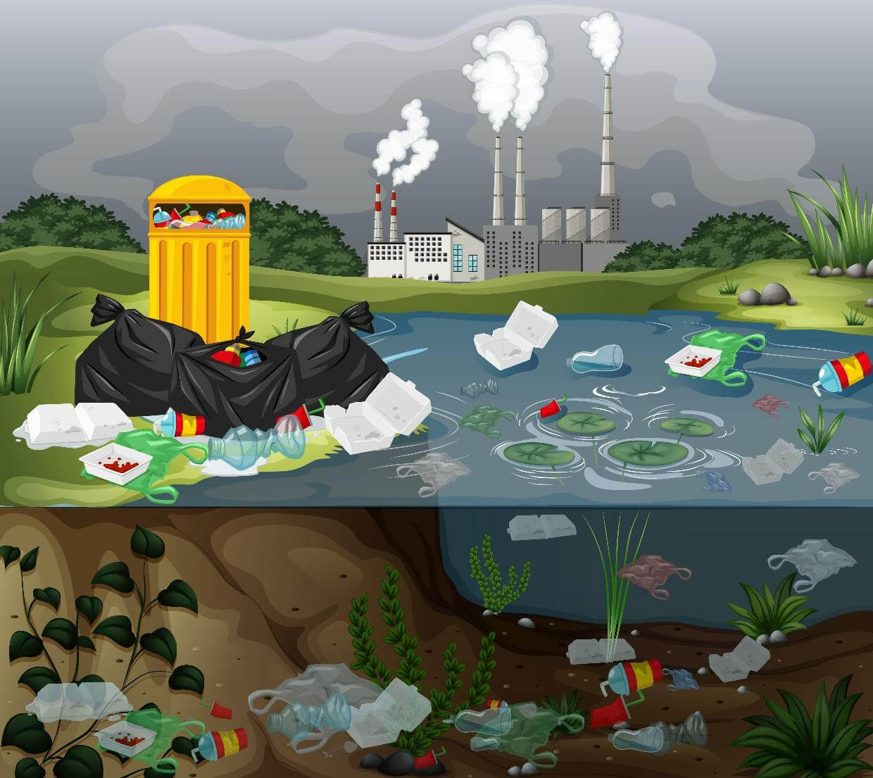
Problem Statement
Water pollution is increasing rapidly due to industrial waste, sewage discharge, and chemical contamination, leading to severe health hazards and environmental damage.
Existing water quality monitoring methods are manual, costly, and time-consuming, requiring laboratory analysis that cannot provide real-time alerts.
Many regions lack access to continuous and automated monitoring systems, making it difficult to detect pollution at an early stage.
There is a need for a smart, efficient, and low-cost solution that can analyze water quality digitally and issue immediate warnings when pollution levels rise.
This project addresses the problem by developing an image-processing–based simulation system capable of evaluating water pollution levels and generating alerts, paving the way for future IoT-based real-time monitoring solutions.

Slide 17
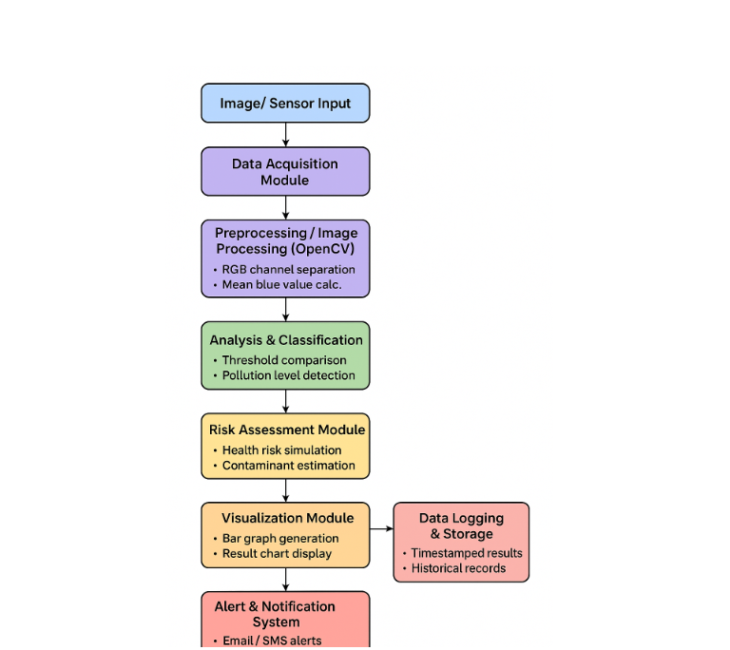
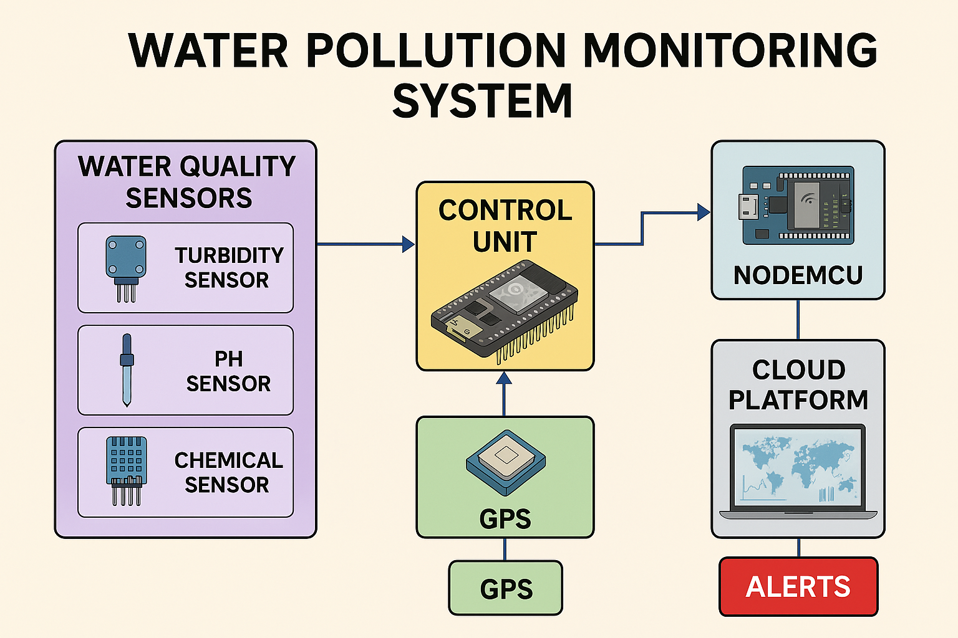
Product Architecture and Design/ Block Diagram

Slide 18
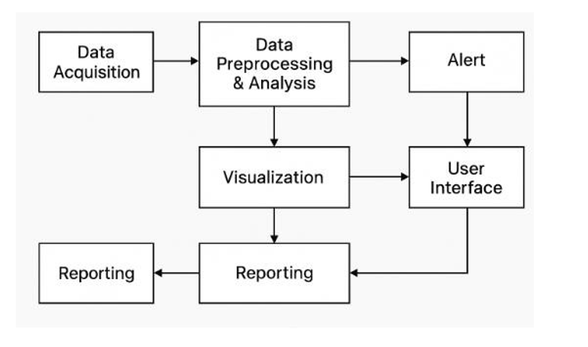
DATA FLOW DIAGRAM

Slide 19
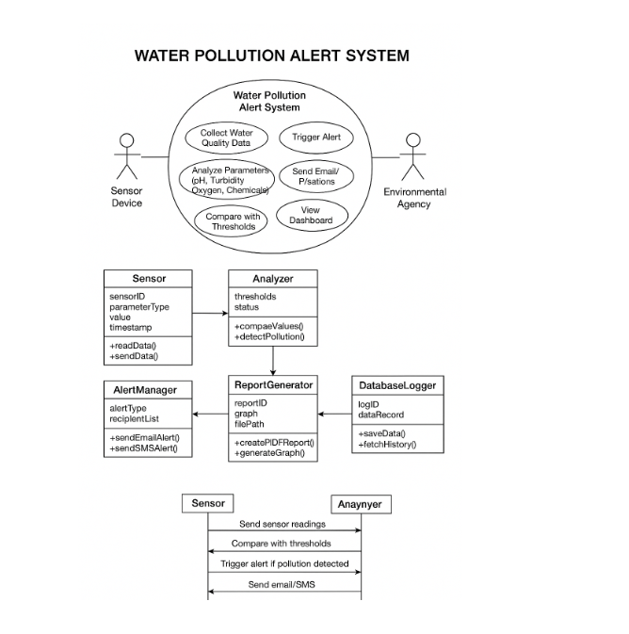
UML DIAGRAM

Slide 20
MODULE DESCRIPTION/COMPONENT SPECIFICATION
Module Name | Description / Functionality
1. Sensor Module | Collects real-time water quality data such as pH, turbidity, dissolved oxygen, and chemical concentration through IoT sensors.
2. Data Processing Module | Cleans, validates, and processes sensor data using Python libraries (NumPy, Pandas) for accurate analysis.
3. Analysis & Decision Module | Compares live readings with predefined safety thresholds to detect pollution levels and classify water quality status.
4. Alert & Notification Module | Generates automated alerts (Email/SMS) using Python’s SMTP and API integrations when pollution exceeds limits.
5. Visualization & Reporting Module | Displays data and alert results through graphical dashboards and generates detailed PDF reports.
6. Database / Logging Module | Stores sensor readings, alert history, and analytical results for audit and future analysis.
7. User Interface Module | Provides real-time system interaction through a GUI (Flask/Tkinter) for operators and administrators.

Slide 21
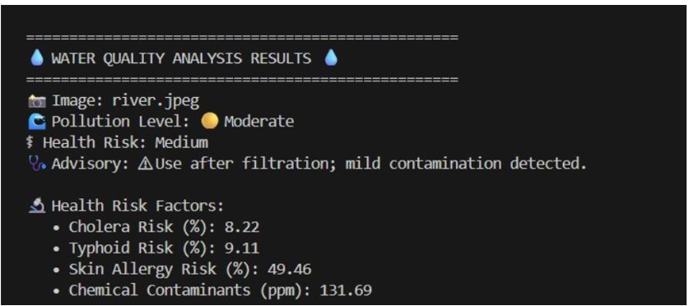
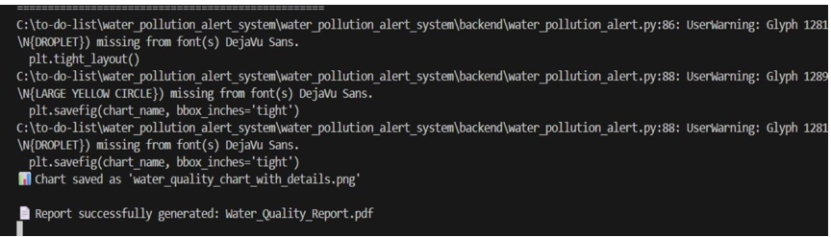
Experimental Results

Slide 22
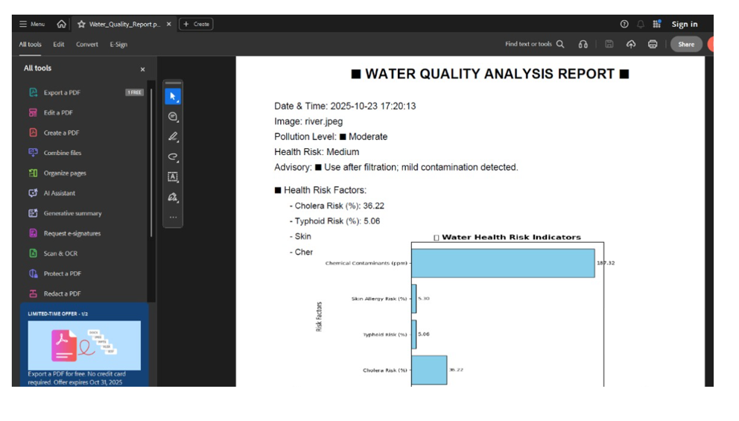
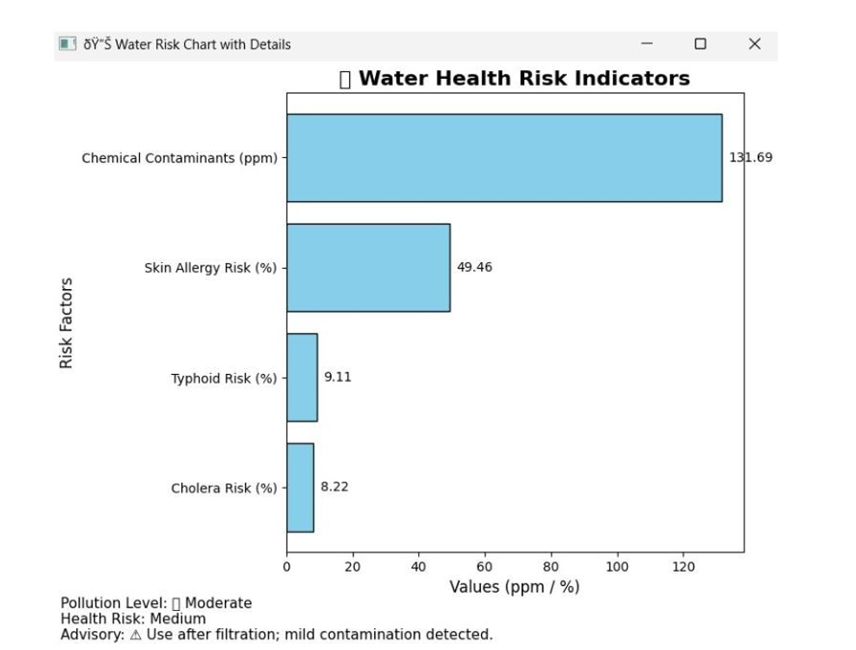
Experimental Results

Slide 23
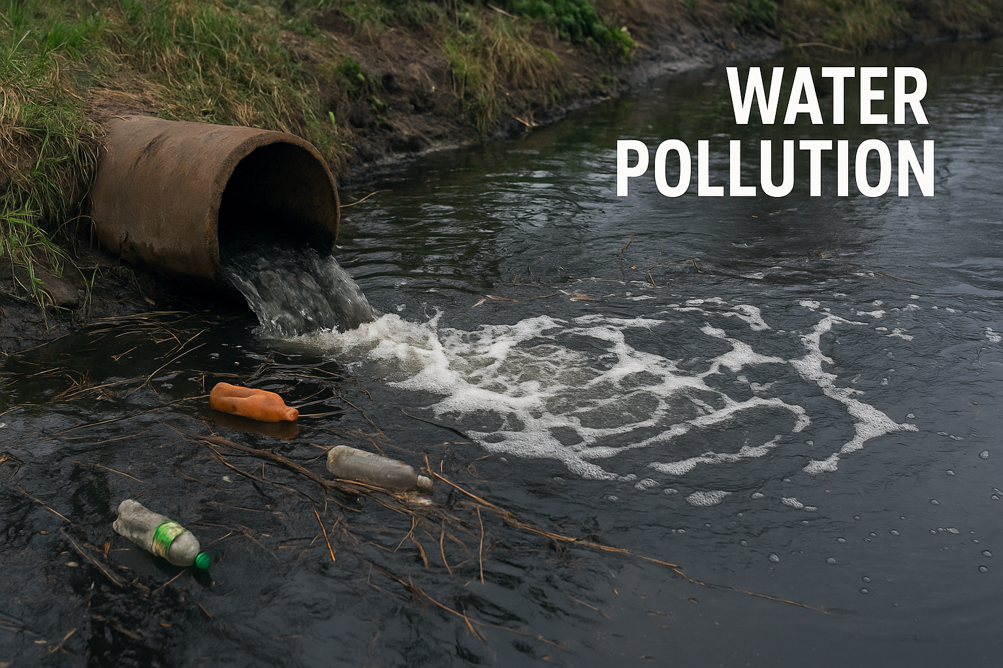
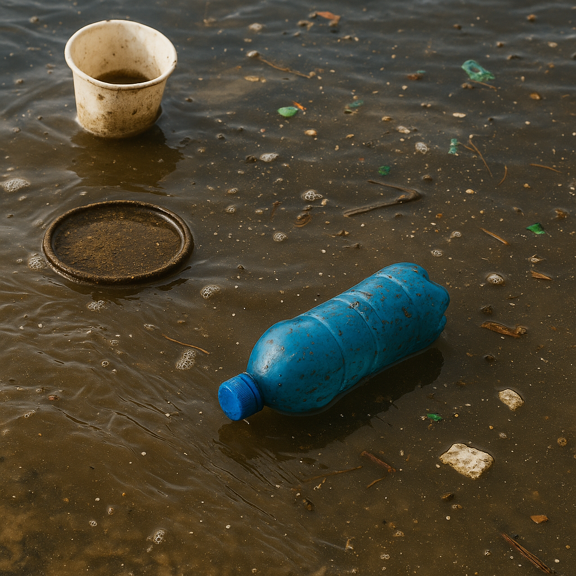
Conclusion
The proposed Water Pollution Alert System successfully demonstrates how Python-based automation can transform traditional water monitoring into a real-time, data-driven solution.
The integration of image processing and sensor technologies allows accurate detection of pollution levels and provides timely alerts to relevant authorities.
The system’s modular architecture ensures scalability, enabling easy integration of additional sensors, data visualization tools, or cloud-based reporting modules in the future.
Through automated data analysis, alert generation, and report creation, the project minimizes human intervention and enhances the efficiency of environmental surveillance.
The developed prototype provides a cost-effective and portable solution, making it suitable for deployment in rivers, lakes, or industrial discharge points for rapid pollution detection.
Overall, the project contributes to sustainable environmental management by offering a reliable, real-time pollution monitoring framework that supports early intervention and public health protection.
.

Slide 24
Future Works
Integration with IoT sensors (pH, turbidity, temperature, conductivity) for real-time water quality data collection.
Development of a cloud-based monitoring dashboard to visualize pollution data and historical trends.
Implementation of machine learning models to predict future pollution levels based on previous readings.
Addition of mobile or web applications for instant user notifications and remote access.
Incorporation of GPS modules for location-based pollution tracking and mapping.
Enhancement of system accuracy and scalability for deployment in large-scale environmental monitoring projects.
Collaboration with municipal and environmental agencies for real-world testing and validation.

Slide 25
Reference
[1] M. Talebkhah, A. Sali, M. Marjani, M. Gordan, S. J. Hashim and F. Z. Rokhani, ”IoT and Big Data Applications in Smart Cities: Recent Advances, Challenges, and Critical Issues,” in IEEE Access, vol. 9, pp. 55465-55484, 2021.
[2] UM. J. Uddin and Y. K. Jeong, ”Urban river pollution in Bangladesh during last 40 years: potential public health and ecological risk, present policy, and future prospects toward smart water management,” in Heiyon, vol. 7, no. 2, 2021
[3] M. Fida, P. Li, Y. Wang, S.K lam and A. Nsabimana, ”Water contami- nation and human health risks in Pakistan: a review,” in Exposure and Health, vol. 15, no. 3, pp. 619-639, 2023.
[4] Guidelines for safe recreational water environments: Coastal and fresh waters (Vol. 1). World Health Organization, 2021.
[5] E. T. de Camargo et al., “Low-Cost Water Quality Sensors for IoT: A Systematic Review,” Sensors, vol. 23, no. 9, p. 4424, Apr. 2023.

Slide 26
Thank You

